Slide 1

The God of All History
Romans 9:1-24

Slide 2
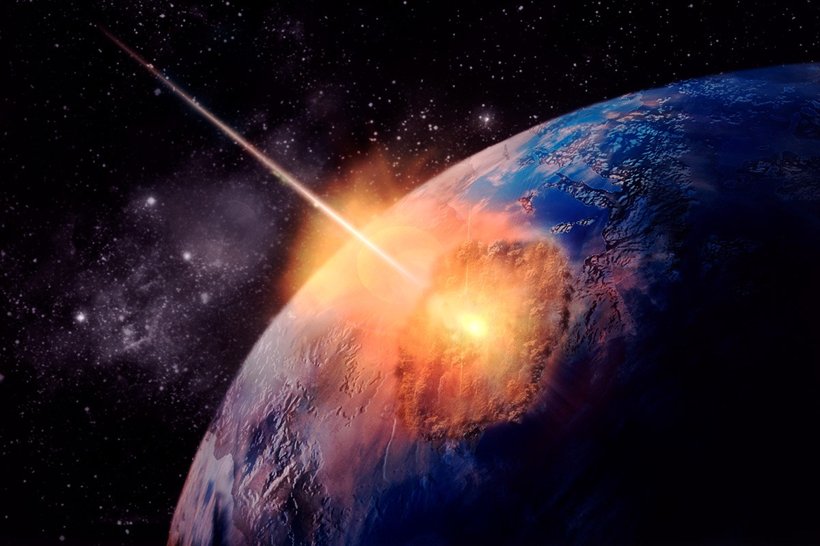

God Reaches Into the Human Condition
I Control My Choice
God Controls All History
As it is written: Look! I am putting a stone in Zion to stumble over and a rock to trip over,
yet the one who believes on Him will not be put to shame.
Romans 9:33
Notes:
Rom.9 THEME = **v.33= **G over ALL History
ZION=Jerusalem, 33AD → JC Crucif.
=“STUMBLE…TRIP” = Understatement! → Upside Dwn!
ALSO: **Indiv. Impact → Nd. 2 See INTERPLAY

Slide 3
Voluntary Slavery
Karma (Buddhism / Hinduism / All Eastern Religions)
Islam: al-qada wa al-qadar
I Control NOTHING
‘IT’ Controls All History
In Islam, the phrase means "the divine decree and the predestination". In Islam, God has predetermined, known, ordained, and is constantly creating every event that takes place in the world. The concept of human will being predetermined by God's will is stated clearly in the Quran: “Verily this (The Holy Quran) is no less than a Message to (all) the Worlds; (With profit) to whoever among you wills to go straight, but ye shall not will except as God wills; the Cherisher of the Worlds.”
The Koran; Section 81, Vs. 27-29 From: Wikipedia, Predestination#Islam
Notes:
SLAVERY=PROBLEM Underst. G’s Part→Man’s Part

Slide 4
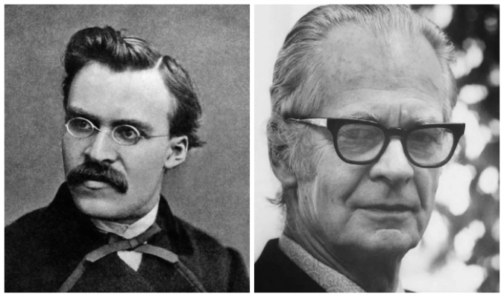

Voluntary Slavery
As a science of behaviour adopts the strategy of physics and biology, the autonomous agent to which behaviour has traditionally been attributed is replaced by the environment…
(Skinner, “Beyond Freedom and Dignity”)
Karma (Buddhism / Hinduism / All Eastern Religions)
Islam: al-qada wa al-qadar
Naturalism/ Behaviorism/ Neuroscientists/ Evolutionists
I Control NOTHING
‘IT’ Controls All History
Notes:
**Nietzsche in “Human, All Too Human” & “Beyond Good & Evil”
We=Animals / Instinct / Herds / Environment
**Skinner = Psychologist / 70s / “Behaviorism” → Educators

Slide 5


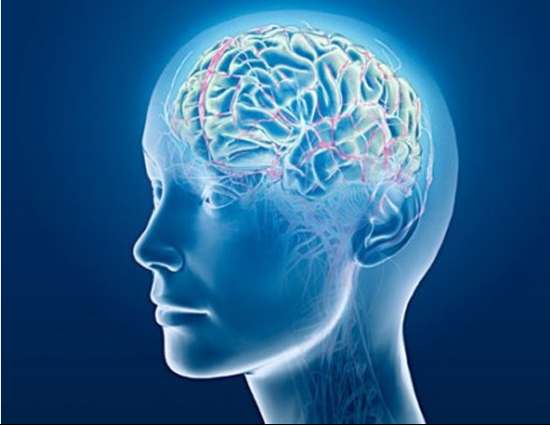
Voluntary Slavery
Karma (Buddhism / Hinduism / All Eastern Religions)
Islam: al-qada wa al-qadar
Naturalism/ Behaviorism/ Neuroscientists/ Evolutionists /Determinism
I Control NOTHING
‘IT’ Controls All History
June, 2016
What Neuroscience Says about Free Will
We're convinced that it exists, but new research suggests it might be nothing more than a trick the brain plays on itself
Scientific American, April 28, 2016
“Determinism…is the argument that all mental phenomena and actions are also, directly or indirectly, causally produced—according to the laws of nature (such as those of physics and neurobiology) —by previous events that lie beyond the control of the agents”
National Institutes of Health, Frontiers in Human Neuroscience
Vol. 10, “Free Will and Neuroscience”

Slide 6
Voluntary Slavery
Karma (Buddhism / Hinduism / All Eastern Religions)
Islam: al-qada wa al-qadar
Naturalism/ Behaviorism/ Neuroscientists/ Evolutionists /Determinism
Infantilism/ Victimization/ Emotionalism/ Postmodernism
I Control NOTHING
‘IT’ Controls All History
Pseudobulbar affect (PBA), or emotional incontinence, is a type of emotional disturbance characterized by uncontrollable episodes of crying and/or laughing, or other emotional displays.

Slide 7
Voluntary Slavery
John Calvin
Institutes
(27 Yrs Old!)
July 10, 1509
1536
Karma (Buddhism / Hinduism / All Eastern Religions)
Islam: al-qada wa al-qadar
Naturalism/ Behaviorism/ Neuroscientists/ Evolutionists /Determinism
Infantilism/ Victimization/ Emotionalism/ Postmodernism
Christianity: Calvinism & derivatives.
I Control NOTHING
‘IT’ Controls All History
Providence – By “It”…
"All events whatsoever are governed by the secret counsel of God."
“Irresistible Grace”
Notes:
**Calvin → Happy B-day! =510 Yrs Old
Instit @27 → =KNUCKLEHEAD
**Providence = “IT” → “Force” → ~RESIST
Irresist.Grace=NICE →Monstrous Implic.
MOVIE

Slide 8
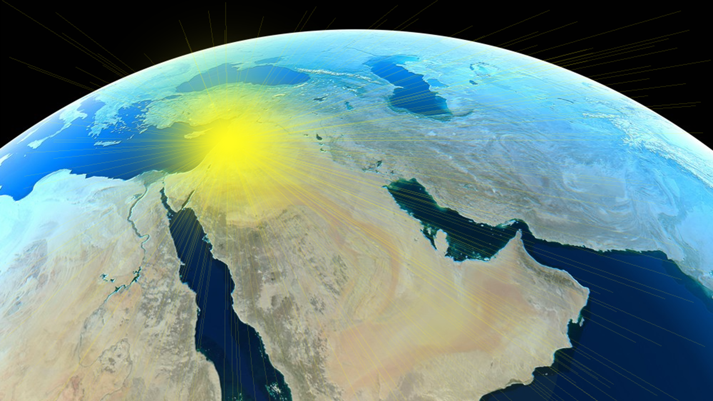
The History of God & Israel
Romans 9:1-2 (NLT2) With Christ as my witness, I speak with utter truthfulness. My conscience and the Holy Spirit confirm it.
My heart is filled with bitter sorrow and unending grief in my heart …
for my people, my Jewish brothers and sisters. I would be willing to be forever cursed—cut off from Christ!—if that would save them.
Notes:
P=BUMMED

Slide 9
The History of God & Israel
Romans 9:3-4 They are the people of Israel, chosen to be God’s adopted children. God revealed his glory to them. He made promises with them and gave them his law. He gave them the privilege of worshiping him and receiving his wonderful promises.
Notes:
Hebrews=LUCKY! → G=Revealed (~2 Scottish!)
=All Sustained by G’s Promises
AP: Exist 2Day by G’s Promises
“WORSHIPPING” = Knowing G → IL: “Friend of G”

Slide 10
The History of God & Israel
Romans 9:5 Abraham, Isaac, and Jacob are their ancestors, and Christ himself was an Israelite as far as his human nature is concerned. And he is God, the one who rules over everything and is worthy of eternal praise! Amen.
Notes:
JC = Purpose 4 Preserving Israel
“Son of David” , etc. = GOD ON EARTH!!
God of Hist: Abraham/Isaac/Jacob
G=Always Identifies Himself That Way

Slide 11
Q: Did God Fail With Israel…? A: No – God’s Plan Goes Beyond Israel
Romans 9:6 Well then, has God failed to fulfill his promise to Israel?
No, for not all who are born into the nation of Israel are truly members of God’s people! This means that Abraham’s physical descendants are not necessarily children of God.
Notes:
“Failed” → Xians=GENTILES!! ??Jews At??
**I.e., “Child, of Abe” = Only Chance 2 Get Saved
Judaism = an ETHNIC Relig = UNBIBLICAL

Slide 12
Q: Did God Fail With Israel…? A: No – God’s Plan Goes Beyond Israel
Only the children of the promise are considered to be Abraham’s children. For God had promised, “…Sarah will have a son.” This son was our ancestor Isaac.
Notes:
I.e., GOD Defined “Israel” → NOT MAN
Abraham Had 2 Kids → Only 1 = ISRAEL

Slide 13
Q: Did God Fail With Israel…? A: No – God’s Plan Goes Beyond Israel
Mal. 1:2 – the Course of 2 Nations
“I have loved you,” says the Lord. But you say, “How have You loved us?”
“Was not Esau Jacob’s brother?” declares the Lord. “Yet I have loved Jacob; but I have hated Esau, and I have made his mountains a desolation…”
Gen. 25:23 – Birth of 2 Nations
The Lord said to her, “Two nations are in your womb; And two peoples will be separated from your body; one people shall be stronger than the other; And the older shall serve the younger.”
Rebekah…gave birth to twins. But before they were born, before they had done anything good or bad… She was told, “Your older son will serve your younger son.” In the words of the Scriptures“I loved Jacob, but I rejected Esau.”
Just as it is written, "JACOB I LOVED, BUT ESAU I HATED."
Notes:
“BEFORE..BORN” → HIDEOUS! → **NASB=More Hideous!
~Babies → **Gen.25=NATIONS → Prophecy: Unbelievers
“Hated” = IDIOM (IL: JC “Hate…mother/father”)
**Mal. 1 = 1500 yrs LATER → NATIONS
I.e., Nations, Nations, Nations, Nations…

Slide 14
Q: Did God Fail With Israel…? A: No – God’s Plan Goes Beyond Israel
Irresistible Grace
“It is a powerful impulse of the Holy Spirit, which makes men willing who formerly were unwilling and reluctant.” Calvin
“a forcible seizure, a holy rape of the surprised will.” Miller, Puritan
Romans 9:14 What shall we say then? There is no injustice with God, is there? May it never be!
For God said to Moses, “I will show mercy to anyone I choose, and I will show compassion to anyone I choose.” So it is God who decides to show mercy. We can neither choose it nor work for it.
Notes:
MOSES = a PERSON, ~a Nation! → “~CHOOSE…” 2b Saved
Said @Mt. Sinai @BIRTH of the Nation
=**Irresistible Grace → From “Nations” 2 “God rapes people”

Slide 15

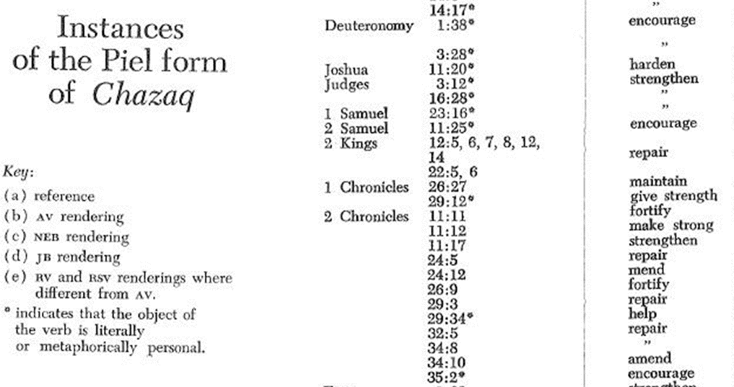
Q: Did God Fail With Israel…? A: No – God’s Plan Goes Beyond Israel
“Why do I feel so hardened today?”
Pry this gun from my cold, dead hands!
Romans 9:17-18 (NASB) For the Scripture says to Pharaoh, "for this very purpose I raised you up, to demonstrate my power in you, and that My name might be proclaimed throughout the whole earth."
So then He has mercy on whom He desires, and He hardens whom He desires.
Notes:
Aha! Pharaoh = INDIVID!
=**Charlton Heston → SO Hardened!
**MOSES=More Hardened.
** “Harden” = “Strengthen/Repair/Fortify/Encourage”
P. WANTED 2 Resist → G=Nudged Him

Slide 16
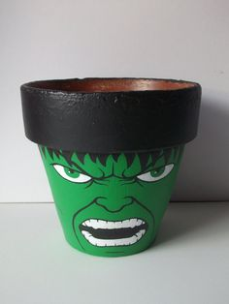

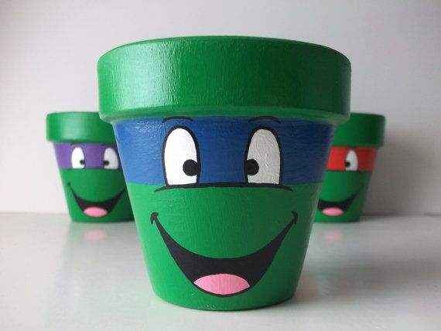
Q: Did God Fail With Israel…? A: No – God’s Plan Goes Beyond Israel
I WISH HERMIMIE WAS HERE…
HEY! WTF!?
Romans 9:19-21 (NASB) ¹⁹ You will say to me then, “Why does He still find fault? For who resists His will?”
On the contrary, who are you, O man, who answers back to God? The thing molded will not say to the molder, "Why did you make me like this," will it?
Or does not the potter have a right over the clay, to make from the same lump one vessel for honorable use and another for common use?
GEE! THANKS MR. POTTER!
Notes:
THIS=**BAD NEWS! → or, **THIS
**& Mr. Potter Says… “Need a SPELL….”

Slide 17
Q: Did God Fail With Israel…? A: No – God’s Plan Goes Beyond Israel
Romans 9:22-24 What if God, although willing to demonstrate His wrath and to make His power known, endured with much patience vessels of wrath prepared for destruction?
And He did so to make known the riches of His glory upon vessels of mercy, which He prepared beforehand for glory
Isaiah 40:17 All the nations are as nothing before Him, They are regarded by Him as less than nothing and meaningless.
Egypt
Israel
Notes:
?? Talking About?? ** Egypt/Israel
&Babylon/Assyrians/Persians/Greeks/Romans
TODAY: Russia → “Hooks…Jaws”
==OFFENSIVE 2 US→ G ~In2 “National Pride”

Slide 18
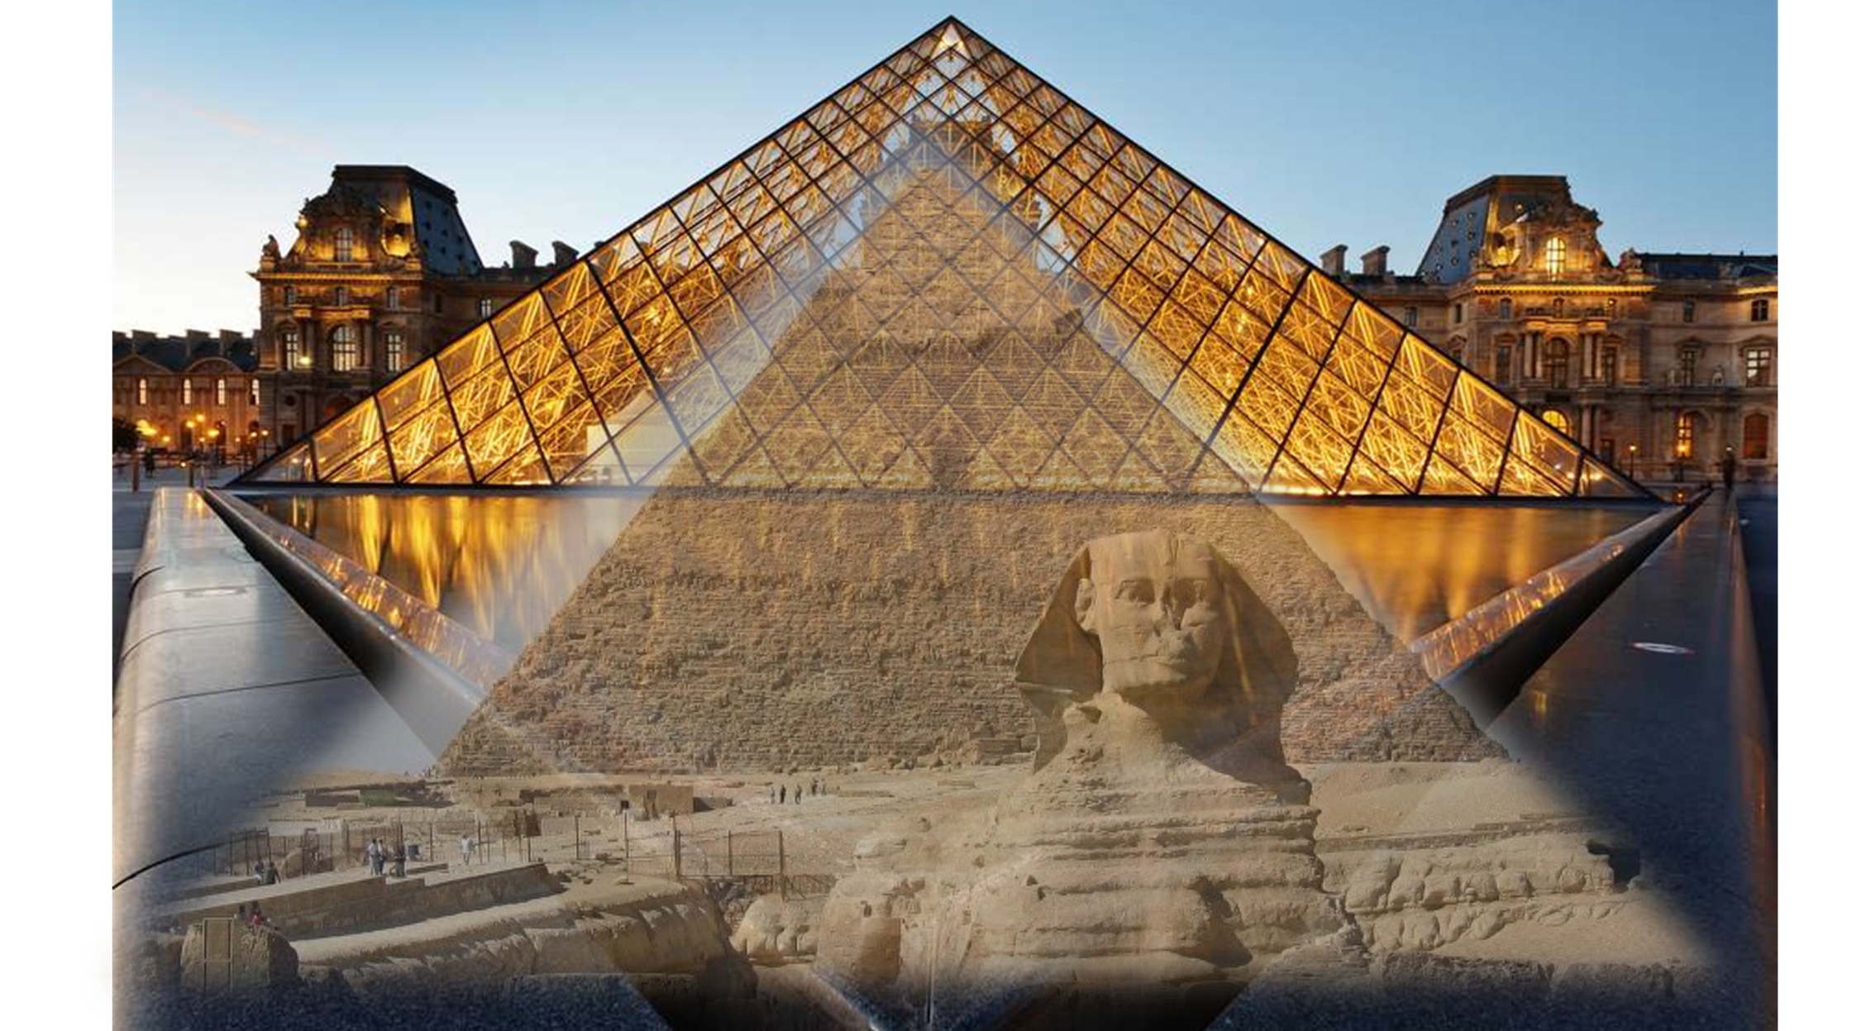
God is Working in Human History
Began With
Israel
Ended With
Israel
Gentiles
Romans 9:24-25 even us, whom He also called, not from among Jews only, but also from among Gentiles. As He says also in Hosea, "I will call those who were not my people, 'my people,' and her who was not beloved, 'beloved.'"
Notes:
**Began…Ended → In-Between? “Oh BTW, ~Pers.Choice”

Slide 19
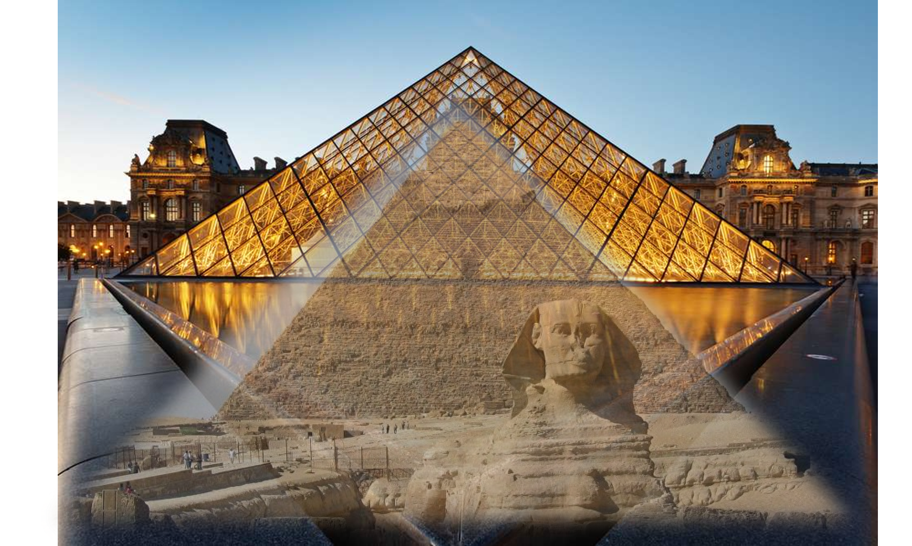
God is Working in Human History
1 Timothy 2:4 who desires all men to be saved and to come to the knowledge of the truth.
For there is one God, and one mediator also between God and men, the man Christ Jesus, who gave Himself as a ransom for all, the testimony given at the proper time.
Notes:
Contradicts Clear : 1Tim.2:4 → Workaround=TORTURE!
?? G.= Working ?? → Reaching Hearts
?? Knowledge ?? = TRUTH: “1 MEDIATOR”
HIST= Proof!! → GOSP: JC=Only Proof Avail!!

Slide 20
A Biblical Respect for God’s Sovereignty:
God is building something at the macro level in human history, imposing limits on evil.
We have choices to make at the micro level in our lives.
Knowing about something does not mean causality
Romans 9:33 as it is written, “Behold, I am laying in Zion a stone of stumbling, and a rock of offense…”
Romans 9:33 as it is written, “Behold, I am laying in Zion a stone of stumbling, and a rock of offense and whoever believes in him will not be put to shame.”
Notes:
**Knowing !=Cause → HUMANS=Know→ ??Blame G??
“Predestin” = OMNISCIENCE = ASSURANCE, ~Threat!!
** MACRO = Nations → ESP. Israel’s Neighb=NXT WK
9:33 “Stone” = CORNERSTONE → 2Day=G’s TEMPLE
** MICRO = 9:33b → AP: “Shame” = Wasting Ur Life

Slide 21
God’s Sovereignty Is Good: Romans 9:33 …and whoever believes in him will not be put to shame.”
To love God brings good purpose and dignity into my life.
God overwhelmingly promotes your freedom / gifts / unique contribution.
Romans 8:28 And we know that God causes all things to work together for good to those who love God, to those who are called according to His purpose.
Romans 8:37 But in all these things we overwhelmingly conquer through Him who loved us.
Notes:
** 2 Luv G = GOOD! Dignity! =Diff Outcome
IE., Life ~RANDOM
=Unleash G 2 Work in Your Life
** AP: Leave Ur SLAVERY
AP: G ~ “Make Me…” → STOP IT!!
AP: Ro. 9:33 / 8:37 → ~Exceptions
AP: Will You LOVE G? DROP Ur Bitterness @G?

Slide 23
A Biblical Respect for God’s Sovereignty Means:
God is unveiling a good plan with purpose in human history.
Loving God brings good purpose and dignity into my life.
God overwhelmingly promotes your freedom / gifts / unique contribution.
Romans 9:33 …and whoever believes in him will not be put to shame.”
Notes:
“WORSHIPPING” = Knowing G → IL: “Friend of G”

Slide 24
God’s BIG Plan…
Romans 9:3-4 …grief in my heart for my people, my Jewish brothers and sisters. I would be willing to be forever cursed—cut off from Christ!—if that would save them.
They are the people of Israel, chosen to be God’s adopted children. God revealed his glory to them.
He made promises with them and gave them his law. He gave them the privilege of worshiping him and receiving his wonderful promises.
Romans 9:5 Abraham, Isaac, and Jacob are their ancestors, and Christ himself was an Israelite as far as his human nature is concerned. And he is God, the one who rules over everything and is worthy of eternal praise! Amen.
Notes:
“WORSHIPPING” = Knowing G → IL: “Friend of G”

Slide 25


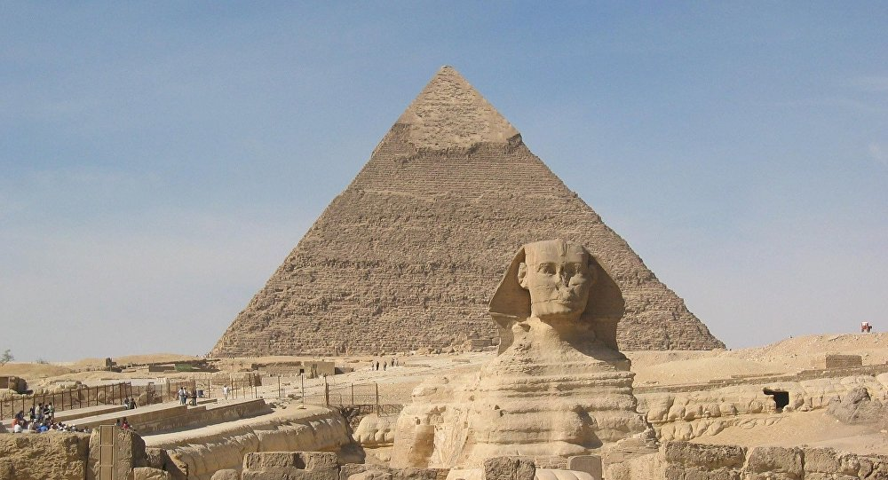
God’s Sovereignty
A Biblical Respect for God’s Sovereignty Means:
God is unveiling a good plan with purpose in human history.
Loving God brings good purpose and dignity into my life.
God overwhelmingly promotes your freedom / gifts / unique contribution.
God is Ultimately Sovereign Over Human History
God Asks to be Sovereign Over Individual Histories
God Is Sovereign Alongside Human Freedom
Romans 9:33 as it is written, “Behold, I am laying in Zion a stone of stumbling, and a rock of offense…”
Romans 9:33 …and whoever believes in him will not be put to shame.”
Romans 8:36-37 …But in all these things we overwhelmingly conquer through Him who loved us.

Slide 26
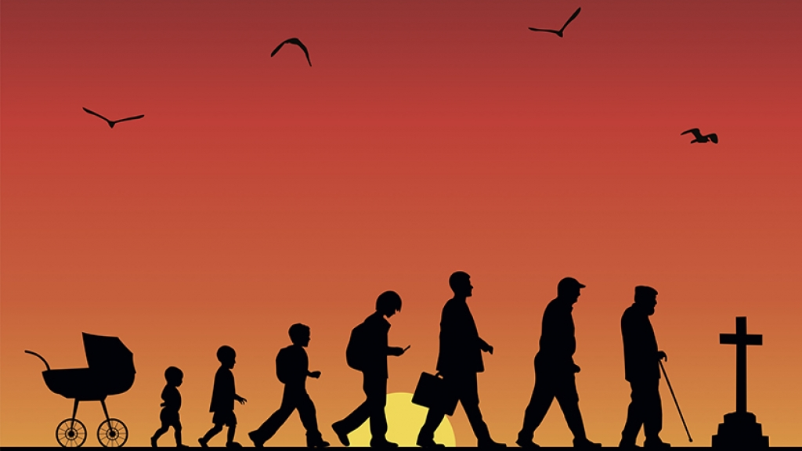

God’s Sovereignty
A Biblical Respect for God’s Sovereignty Means:
God is unveiling a good plan with purpose in human history.
Loving God brings good purpose and dignity into my life.
God overwhelmingly promotes your freedom / gifts / unique contribution.
God is Ultimately Sovereign Over Human History
God Asks to be Sovereign Over Individual Histories
God Is Sovereign Alongside Human Freedom
Romans 9:33 as it is written, “Behold, I am laying in Zion a stone of stumbling, and a rock of offense…”
Romans 9:33 …and whoever believes in him will not be put to shame.”
Romans 8:36-37 …But in all these things we overwhelmingly conquer through Him who loved us.

Slide 27
God’s Sovereignty
A Biblical Respect for God’s Sovereignty Means:
God is unveiling a good plan with purpose in human history.
Loving God brings good purpose and dignity into my life.
God overwhelmingly promotes your freedom / gifts / unique contribution.
God is Ultimately Sovereign Over Human History
God Asks to be Sovereign Over Individual Histories
God Is Sovereign Alongside Human Freedom
Romans 9:33 as it is written, “Behold, I am laying in Zion a stone of stumbling, and a rock of offense…”
Romans 9:33 …and whoever believes in him will not be put to shame.”
Romans 8:36-37 …But in all these things we overwhelmingly conquer through Him who loved us.

Slide 28
Conclusions
A Healthy Respect for God’s Sovereignty Means:
Understanding today’s world in light of God’s history & God’s prophecy.
Deepening a relationship with God means “all things work together for good”
Affirming / respecting / promoting human freedom.
God is Ultimately Sovereign Over Human History
God Asks to be Sovereign Over Individual Histories
God Is Sovereign Alongside Human Freedom

Slide 29
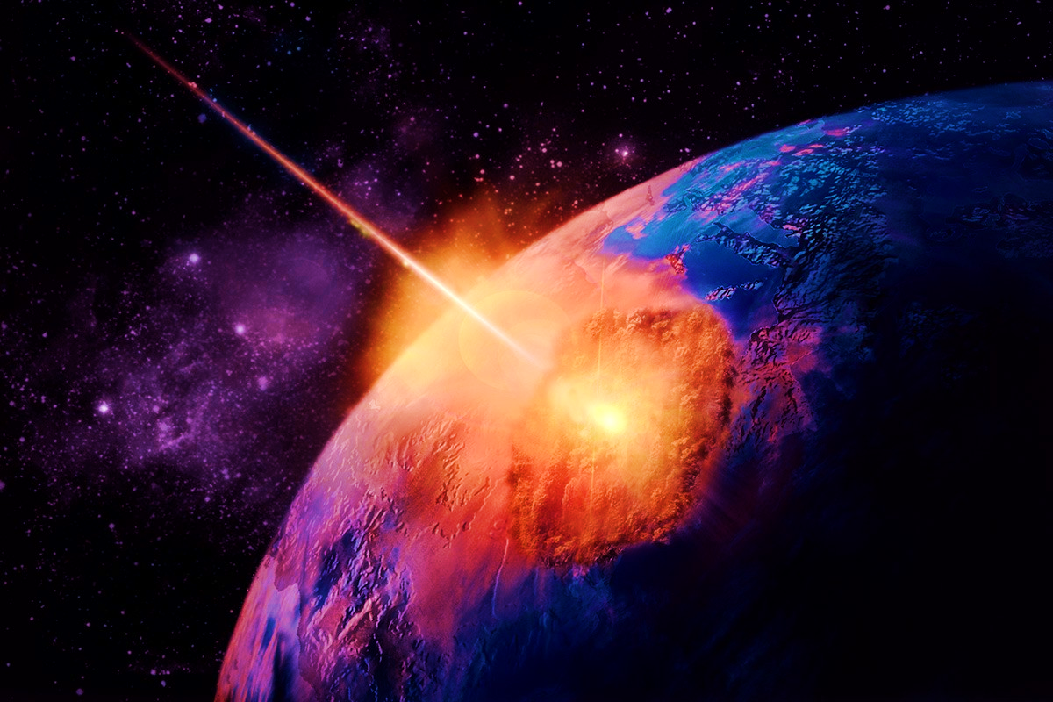
God Promised to Reach Inside Human History
33 AD
What We Have Seen
Romans 8:28 We know that all things work together for the good of those who love God…
Romans 8:36-37 …But in all these things we overwhelmingly conquer through Him who loved us.
As it is written: Look! I am putting a stone in Zion to stumble over and a rock to trip over, yet the one who believes on Him will not be put to shame. Romans 9:33

Slide 30
God Reaches Into the Human Condition
My Life Here & Now
Human History
Romans 9:33 As it is written: Look! I am putting a stone in Zion to stumble over and a rock to trip over, yet the one who believes on Him will not be put to shame.
Glorification
Identification
Justification

Slide 31
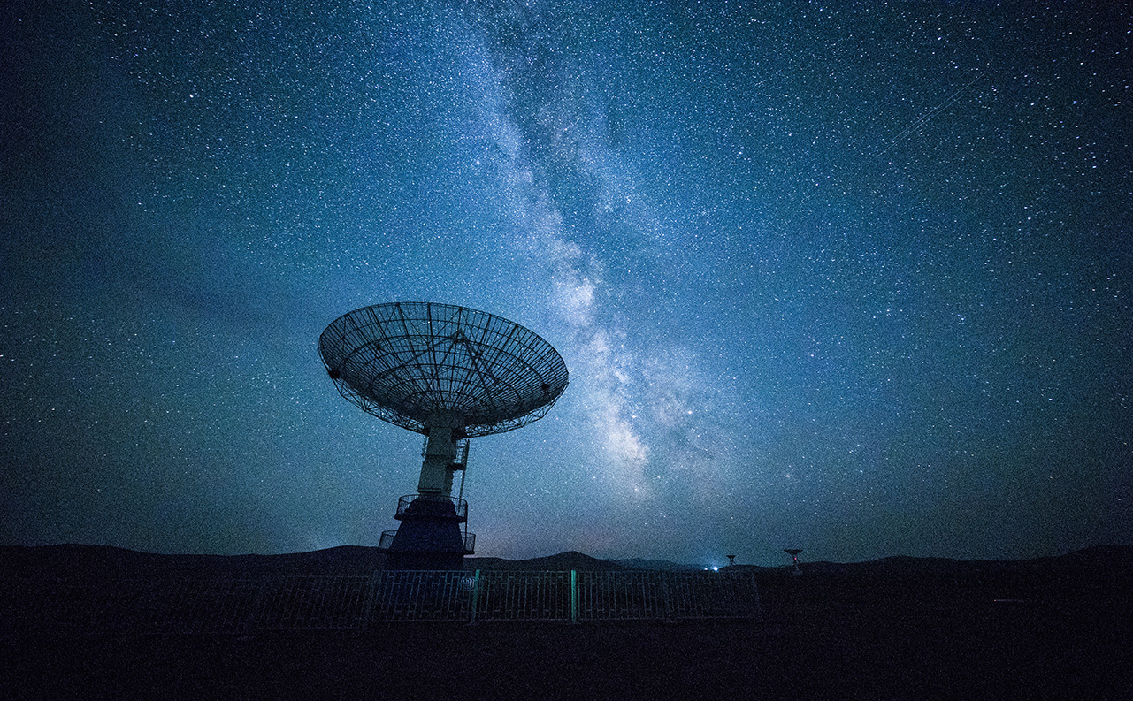
Network Technology
Problem Solving
Algorithm
Automation

Slide 32

Conclusions
someone@example.com

Slide 33
God Reaches Into the Human Condition
I Control My Choice
God Controls All History
Romans 8:28 And we know that God causes all things to work together for good to those who love God, to those who are called according to His purpose.
NOT all God:
“God causes all things”
NOT all Me:
“according to MY purpose”
Notes:
**I.e., Ur BLIP = Part of a BIGGER Picture
**Coming Out of Ro.8:28ff
Understand “MY Life…” = Underst. “HIS PURP…”
ALL History = “G’s History” ← ~Ignore G’s Hist
YET: **~Exaggerate “G’s Hist”

